Slide 1
Air fryer Market Demand Estimation
By: Calvin pan, zilan saadi, eric lin, kayleen do & mercy soly

Slide 2
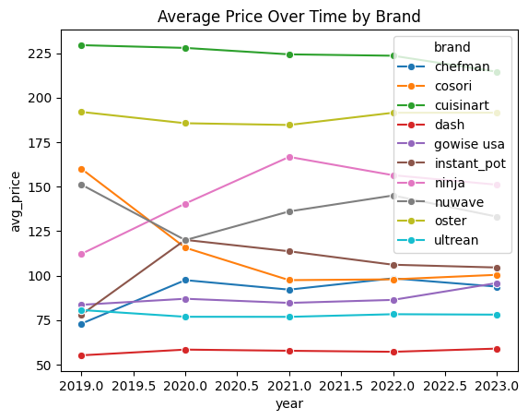
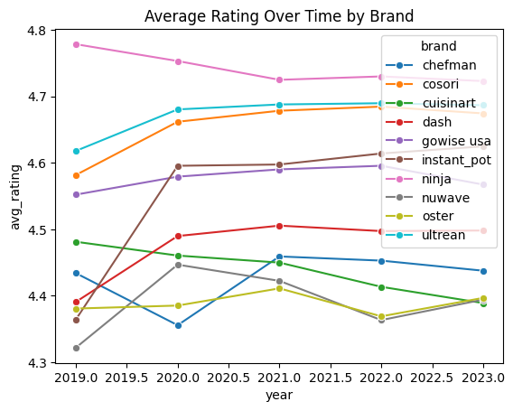
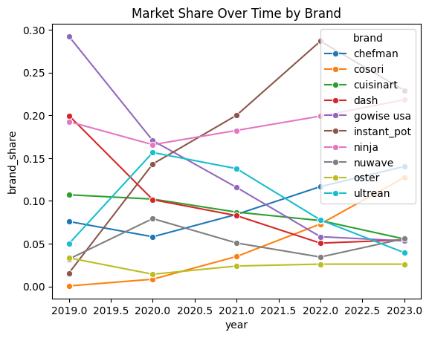
Air-Fryer Market Overview
Price range: $55–$230 across 10 brands
Stable, competitive market segmented by price
Premium: Cuisinart Budget: Dash, Gowise
Instant Pot rises to dominance; Gowise declines
Average Price Over Time
Average Rating Over Time
Market Share Over Time

Slide 3
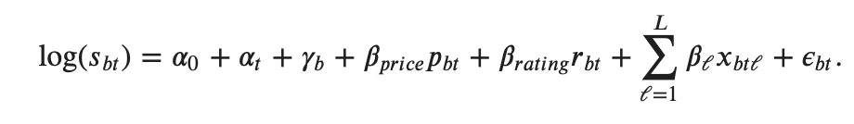
Demand Model Overview
Specification
We estimate a logit-style demand model by running OLS on log brand market share. Taking logs linearizes the multinomial discrete choice problem and lets us recover interpretable demand parameters.
Where
b indexes brands; t indexes years
s_{bt} = brand market share
p_{bt} = average price
r_{bt} = average rating
x_{bt}^{ℓ} = product characteristics
α_{t} = year fixed effects; γ_{b} = brand FE
β_{price} = single price coefficient, shared across all brands and years

Slide 4
Estimated Price Coefficient & Sign Importance
𝛽^𝑝𝑟𝑖𝑐𝑒 = -0.0384
The negative sign matters because it means that there is an inverse relationship between price and product share.
The Law of Demand: As price increases, product share decreases.

Slide 5
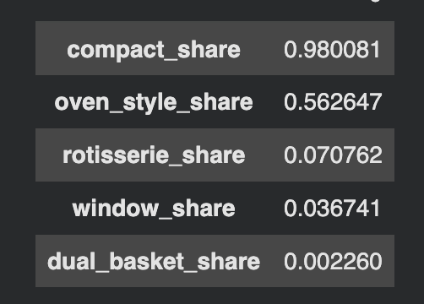
Product Features
The features of being compact, having a dual basket, and having a transparent window are associated with higher demand.
The most common feature is compact design with an average share of about 98%. Additionally, oven-styled models are also common with a share of about 56%.
Rare Features: Rotisserie and Window; where Rotisserie appears in only about 7% and a Window is less than 4% of air fryer models/brands.

Slide 6
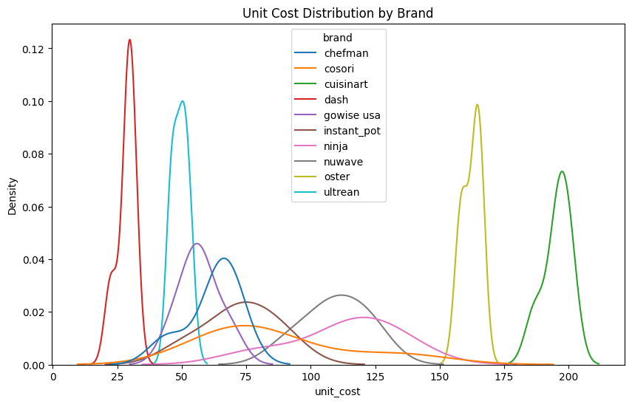
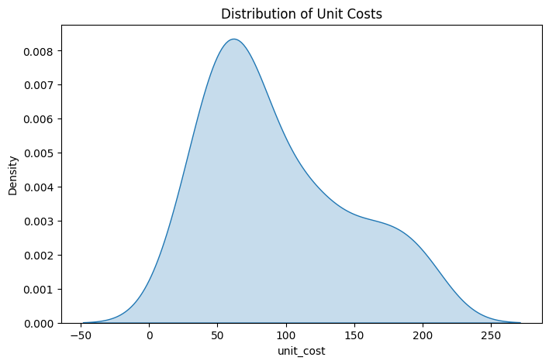
Estimated Unit Costs
Most unit costs are around $50-$100
The distribution is right skewed, with some higher cost products starting at $200+
The variation stages travel across three categories: low-cost, mid-range, and high-cost segments.
Overall, most firms are mid-cost, but a few operate in either premium or budget ranges.

Slide 7
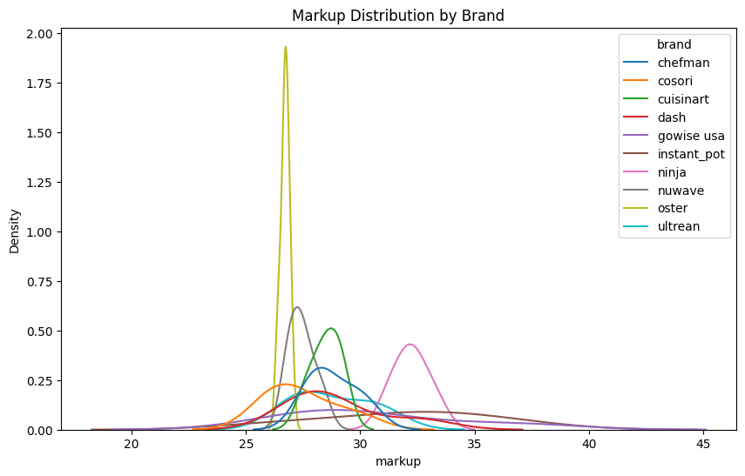
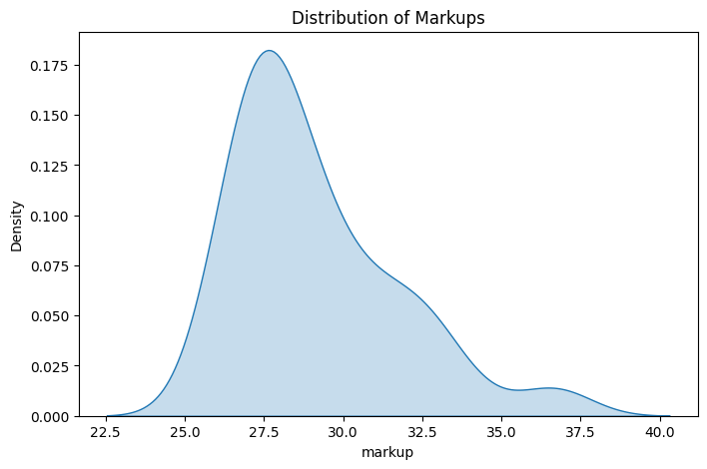
Markups
The market is centered around moderate, stable markups ($27-$30).
A few firms earn higher-than-average markups, suggesting market power or differentiation.
Extremely low markups are rare, implying a competitive but still profitable market.
Ninja and Instant Pot have the highest markups ($31-$34) = strong pricing power
Chefman and Ultrean are mid-range ($27-$30) = competitive pricing.
Overall, most brands have similar markups and a few brands stand out with higher markups due to stronger demand or brand reputation.

Slide 8
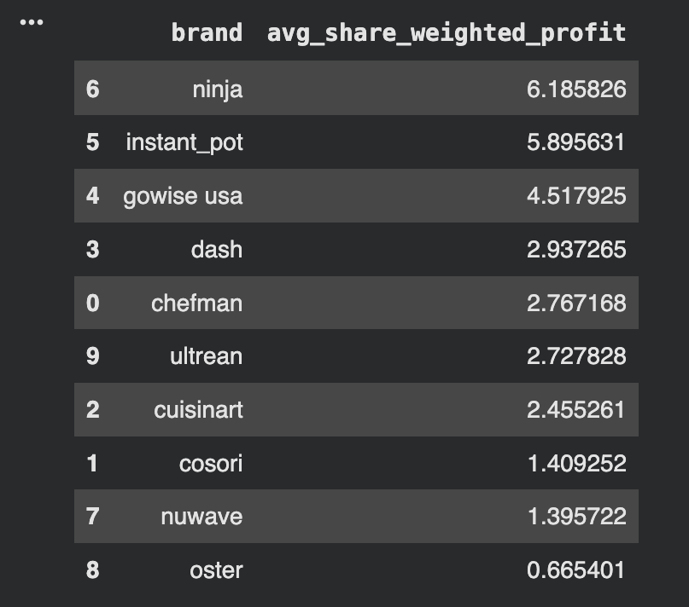
Share-Weighted Profits
Ninja, Insta Pot and Gowsie USA have the highest share weight average profit. These brands generally have a strong brand effect and consistently high market shares.
They generate high profits through higher markups and large market shares, indicating strong pricing power and consumer preference in the market.

Slide 9
Final Conclusions & Thank You!
The air fryer market is separated into premium, mid-range, and budget brands.
Cuisinart, Oster, and Ninja operate in the premium segment, with the highest unit costs (often $150–$200+) and relatively high markups. These brands rely on strong brand recognition and perceived quality to justify higher prices, even though higher cost does not necessarily lead to higher ratings.
Most brands, including Cosori, Chefman, and NuWave, fall into the mid-range, with unit costs around $50–$100 and markups near $27–$30. This is the most competitive part of the market, where brands compete closely on price and features.
At the lower end (budget brands), Dash, Ultrean, and Gowise USA operate with low unit costs (~$25–$50) and slightly lower markups, suggesting a focus on affordability and higher sales volume.
In terms of performance, Ninja and Instant Pot stand out by combining higher markups with strong market share, leading to the highest share-weighted profits. Overall, the market is competitive, but a few strong brands are able to differentiate themselves and earn greater profits through pricing power and demand.

